Slide 1



1
Search Engine Optimization
Increase your Website’s Visibility on Search Engines
<Your logo here>
Powered by SEOteam

Slide 2

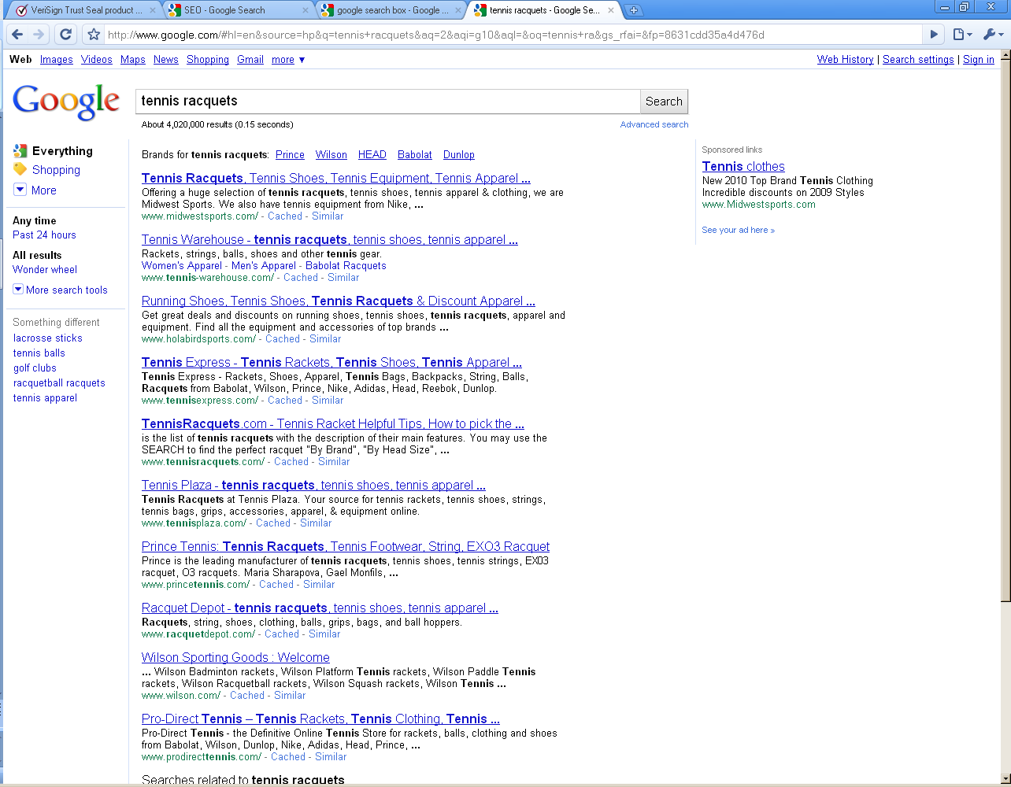
Introduction
92% of internet users try Google, Yahoo! or Bing first while making a purchase decision
93% of these users don’t look beyond page 1 of Search Results
If a business does not feature here, it is missing out!
<Your logo here>
Powered by SEOteam

Slide 3
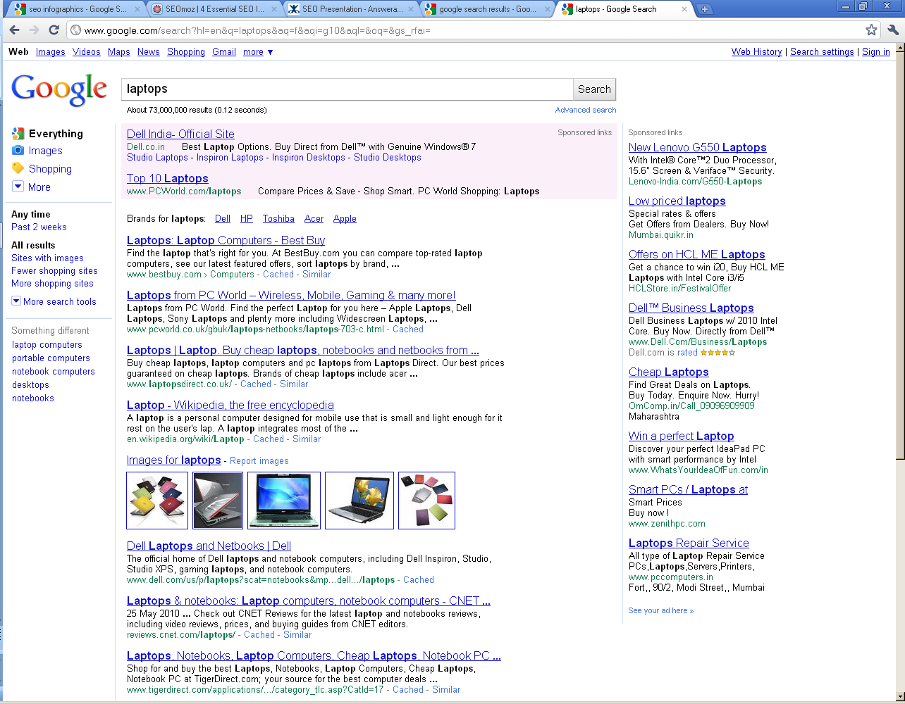
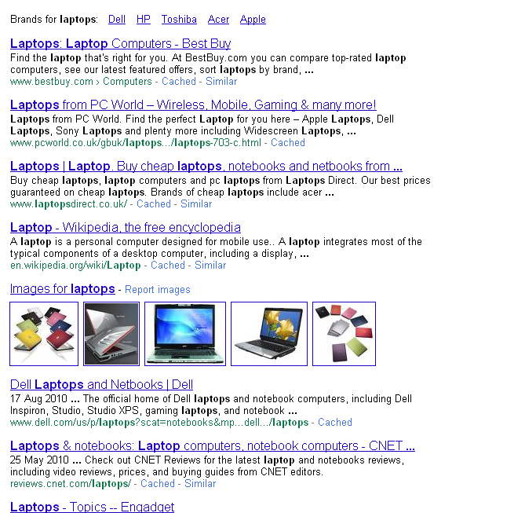

Enter.. Search Engine Optimization!
  SEO is the technique of improving a Website’s visibility in the “natural” or “organic” results of Search Engines, thus increasing the traffic it receives.
Paid Results / Advertising
Organic Results
Research suggests that:
33% of internet users believe that companies found high among search results are trusted brands
b. Natural Search has 4 times more conversions than Paid Results
<Your logo here>
Powered by SEOteam

Slide 4


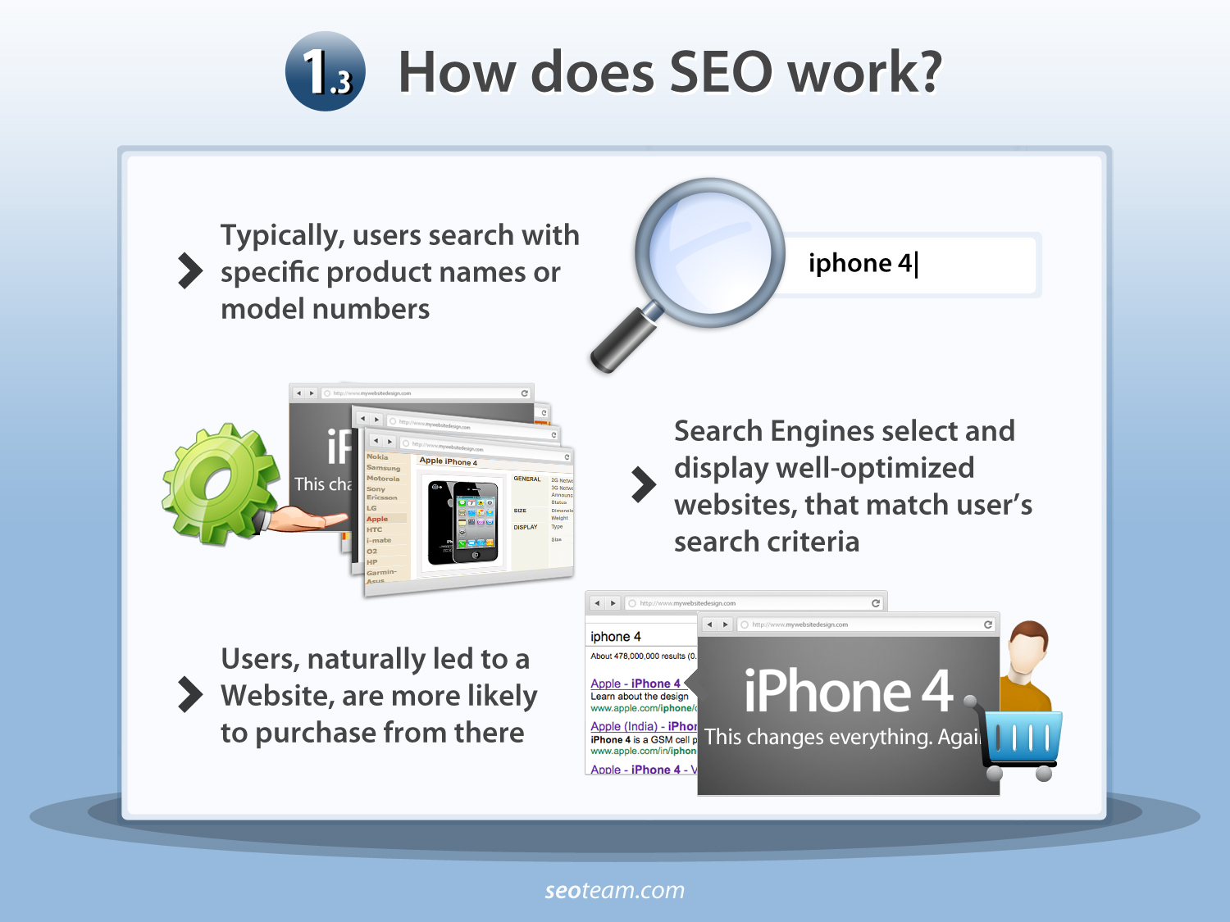
How Does SEO Work?
Typically, users search with specific product names or model numbers
iPhone 4
Search Engines select and display well-optimized websites, that match user’s search criteria
Users, naturally led to a Website, are more likely to purchase from there
<Your logo here>
Powered by SEOteam

Slide 5
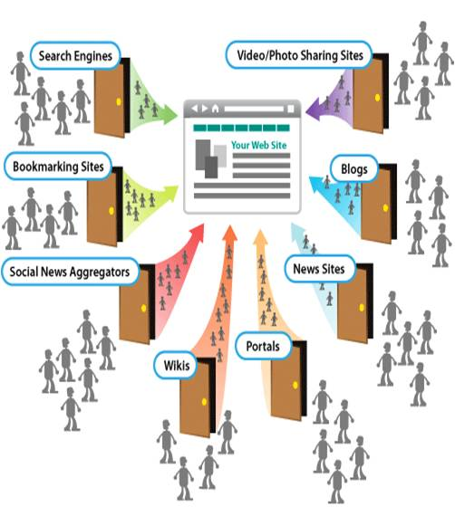
Open Your Doors to Meaningful Traffic
With the evolution in the Web2.0 landscape, tap into upcoming marketing avenues and grow your business
  360 degree SEO touches various portals that
  can help you open your doors to meaningful traffic!
<Your logo here>
Powered by SEOteam

Slide 6







How Can SEO Help Your Business?
Now that you have set up your basic Web Presence, showcase your website to the world!
With SEO, you can:
Reach out to a Global Audience
Attract Qualified Traffic
Register Better Conversions
Boost Profits
Build Your Brand
Top Search Engine Ranking is a Non-Stop
24/7 Advertising Campaign
<Your logo here>
Powered by SEOteam

Slide 7
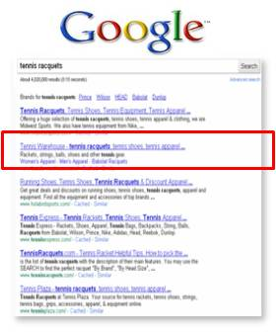
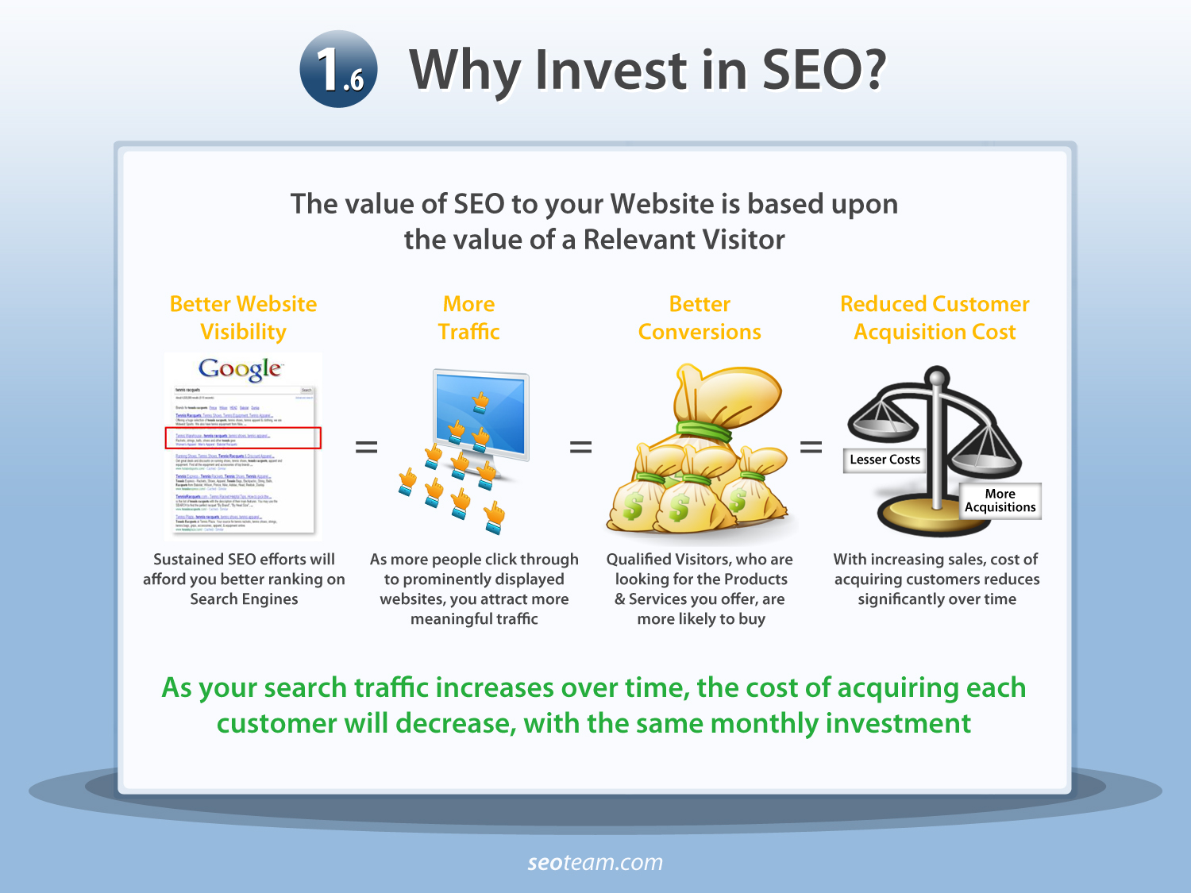

Why Invest In SEO?
Better Website Visibility
More Traffic
Better Conversions
Reduced Customer Acquisition Cost
Sustained SEO efforts will afford you better ranking on Search Engines
As more people click through to prominently displayed websites, you attract more meaningful traffic
Qualified Visitors, who are looking for the Products & Services you offer, are more likely to buy
With increasing sales, cost of acquiring customers reduces significantly over time
As your search traffic increases over time, the cost of acquiring each customer will decrease, with the same monthly investment
<Your logo here>
Powered by SEOteam

Slide 8
Your Average Monthly Investment
While the SEO industry is fairly fragmented, experts agree on the following as Average Full Service Prices:
Service | Low End | Mid Range | High End
Site Review + Consulting | $500 | $2,500 | $10,000
Optimizing Pages/HTML Code | $2,000 | $10,000 | $50,000
Manual Link Building Campaign | $500 | $5,000 | $20,000
Keyword Research Package | $100 | $500 | $2,000
Monthly Retainer for Ongoing SEO | $2,500 | $7,500 | $20,000+
Source: SEOmoz.org
We bring you an amalgamation of all the above, and much more at extremely affordable rates!
<Your logo here>
Powered by SEOteam

Slide 9

Our Latest Offering…
A unique enhancement to further your Web Presence goals!
In partnership with:
Now you can avail of an All-Inclusive Service, performed by a team of SEO Experts, allowing you to reach new heights on the Search Engines.
<Your logo here>
Powered by SEOteam

Slide 10

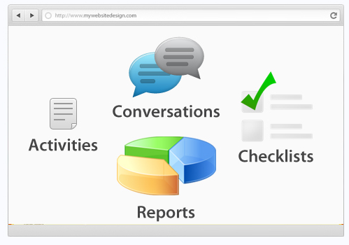
A Comprehensive Service
A Team of Experts to Handle ALL Optimization
  One-on-One Consultancy to understand your Business needs
  A Customized SEO strategy based on your Chosen Keywords
  Ongoing Rank Monitoring
  24/7 Support
Live Project Tracking
  Monitor your Project(s) through our Online Workflow Manager
  Participate in all Planning and Strategy
  Review & Approve all work done on your Website
  Reach your Website Optimizer any time
<Your logo here>
Powered by SEOteam

Slide 11














Service Components
Designed with the latest and most-demanded trends in Online Marketing!
  Core Features
  Hand-picked Keywords
  Advanced On-Page Optimization
  Effective Link Building
  Article and Press Release Submission
  Local Search Optimization
Social Media
Organic SEO
Link Building
  Enhancements
  Social Media Marketing
  Photo-sharing
  Online Video Submissions
  Presentation Submissions
  Reputation Management etc.
Local Search
Video Submissions
Photo Sharing
Presentation Submissions
Analytics
Make the 2 Billion Internet Users your Target Audience
<Your logo here>
Powered by SEOteam

Slide 12
Packages
Basic
$249/month
10 Keywords
On page Optimization
Link Building
Local Search
Monthly Reports
Advance
$549/month
25 Keywords
On page Optimization
Link Building
Local Search
Monthly Reports
Social Media Optimization
Pro
$899/month
50 Keywords
On page Optimization
Link Building
Local Search
Monthly Reports
Social Media Optimization
Reputation Management
Custom
$1,999/month
UNLIMITED Keywords
On page Optimization
Link Building
Local Search
Monthly Reports
Social Media Optimization
Reputation Management
All tailored to your needs
<Your logo here>
Powered by SEOteam

Slide 13


Welcome to Our Exclusive Pre Launch
Avail of heavy discounts by participating in our Beta Program:
Packages | List Price | Beta Price | Discount
Basic | $249/m | $99/m | 60%
Advanced | $549/m | $249/m | 55%
Pro | $899/m | $349/m | 61%
Custom | $1,999/m | $849/m | 58%
Participants will be selected on a First-Come-First-Serve basis
<Your logo here>
Powered by SEOteam

Slide 14


Contact Us
<www.gesture.co.in>
Start with a preliminary, NO OBLIGATIONS SEO Audit of your Website and know your performance on the Search Engines and potential Areas of Improvement!
Visit – http://gesture.co.in
<Your logo here>
Powered by SEOteam

